Slide 1
flexdashboard: a poor man’s Shiny

Slide 2
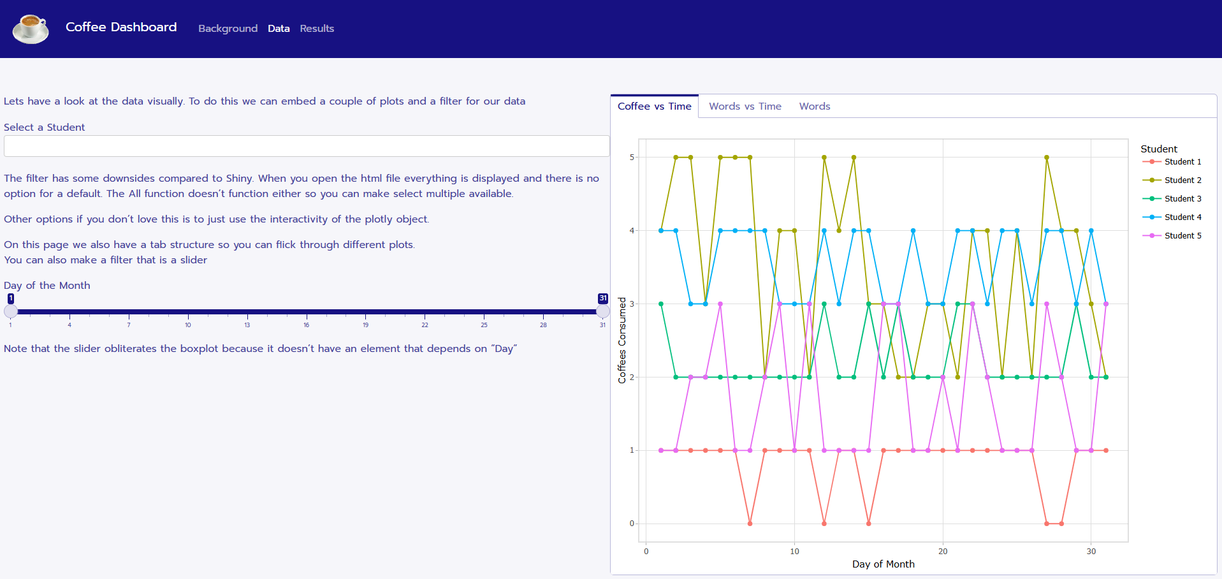
What are flexdashboards?
flexdashboard is an R package to create interactive dashboards from a markdown file
Save as html files

Slide 3
Why flexdashboards?
Coaches and athletes like interactive things
Easy to build
Secure Shiny servers are expensive
Created files can be securely shared and stored

Slide 4
Plan for Today
Flexdashboard example
Peek under the hood
General structure
Available features
Limitations

